Slide 1
SWBAT review answers to a practice exam.
APES 4/22/16

Slide 2
Agenda
Pass Back Mock Exam
Go Over Mock exam answers
Dry Runs (if time)
Tips for the day of the Exam

Slide 3
Mock Exam Notes
Percent Increase: (final –original) /original
Methane is a greenhouse gas --> link this to global warming
China has greater CO2 emissions because it has a greater population
CO₂ is not a component of smog
Always state a specific pollutant ☺

Slide 4
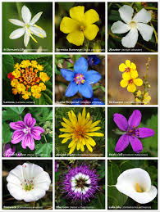
Percent Increase Practice
Attia has 6 flowers on Monday. She goes flower picking again on Friday and ends with 24 flowers. What is the percent increase of flowers?
300%

Slide 5
Stages in Coal Formation over Millions of Years
Increasing moisture content
Increasing heat and carbon content
Peat
(not a coal)
Lignite
(brown coal)
Bituminous
(soft coal)
Anthracite
(hard coal)
Heat
Heat
Heat
Pressure
Pressure
Pressure
Partially decayed plant matter in swamps and bogs; low heat content
Low heat content; low sulfur content; limited supplies in most areas
Extensively used as a fuel because of its high heat content and large supplies; normally has a high sulfur content
Highly desirable fuel because of its high heat content and low sulfur content; supplies are limited in most areas

Slide 6
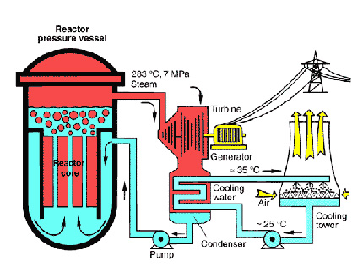
Dry Run: Nuclear Energy
Nonrenewable energy (isotopes of Uranium)
Nuclear fission
Nuclear fusion
Safety issues:
Meltdown
Explosion
Nuclear weapons
Highly radioactive waste
Thermal pollution
NIMBY
Chernobyl
Three Mile Island
Fukushima
Yucca Mountain

Slide 7
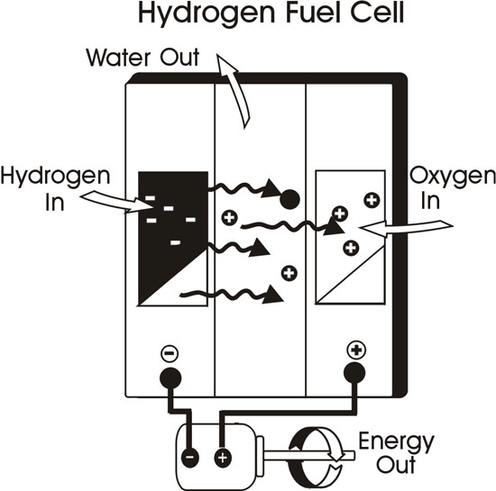
Dry Run: Renewable Energy
Hydroelectric energy
Biofuels
Biodiesel
Gasohol (10% ethanol, 90% gasoline)
Ethanol
Solar energy
Passive energy
Active energy
Wind power
Geothermal Energy
Hydrogen Cells
Ocean Tides

Slide 8
Homework
FRQ packet- 14 total!
Include the original FRQ and the reflection sheet
Tips for studying this weekend:
APES in a box videos on vimeo
CrashCourse Youtube videos!
Do Practice exams in your A.P. review book

Slide 9
Tips for the Exam Day!
DO NOT STAY UP ALL NIGHT STUDYING!!!!
Remember: be at school by 7:30 a.m.
This test is a marathon, not a sprint!
Multiple choice:
Skip questions you’re completely unsure of and come back to them
If you have to guess, guess all the same letter
FRQ:
Don’t overthink the question! You definitely know something about the topic
Pay attention to the verb: identify, discuss, explain, describe
Pay attention to environmental vs. economic vs. societal
Write about 3 sentences per letter
Begin with the one you know the most about
Remember- the math always has a non-math portion!

Slide 10
Ms. McDaniel’s Educated Guesses on FRQ Topics
Keystone Pipeline
Thermohaline circulation
Ebola/diseases
LD50
Indoor Air Pollution
Mining
Drought/Desalinization
Human Population growth/demographic transition model
Experimental Design

Slide 11
But most importantly….
Be CONFIDENT going into the exam
Be proud of all the work you’ve done this year….
Because I’m really proud of all of you ☺

