Slide 1
“Cocaine to Blame for Rain Forest Loss, Study Says”
Amrat Tahir

Slide 2
What is the issue?
Coca planting is linked to deforestation and is reducing biodiversity in the rainforests of Colombia.

Slide 3
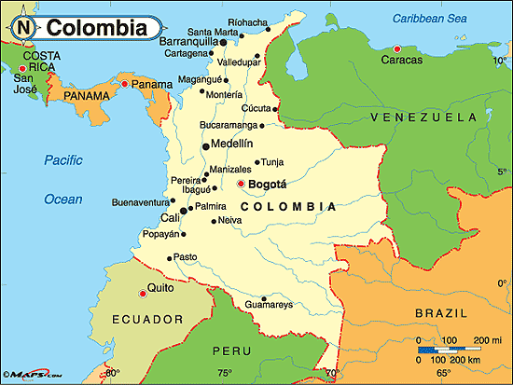
Where in the world?
Colombia

Slide 4
Why does it matter?
First off, what is deforestation?
Deforestation is the conversion of forests to pasture, cropland, urban areas, or other landscapes that have few or no trees remaining.
What are the effects of deforestation?
Cut down trees → Less trees in ecosystem → Habitat loss for organisms → organisms in danger → less biodiversity
Deforestation accounts for nearly 20% of human-caused greenhouse gas emissions in the world.
How does less biodiversity affect me?
Reduced biodiversity means millions of people face a future where food supplies are more vulnerable to pests and disease, and where freshwater is in irregular or short supply.
Rise in climate change where the effects are tremendous as seen in the book “Eaarth”

Slide 5
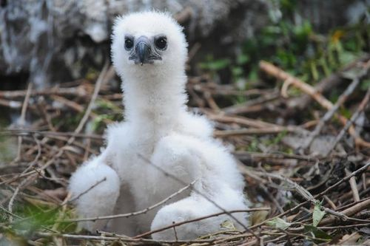
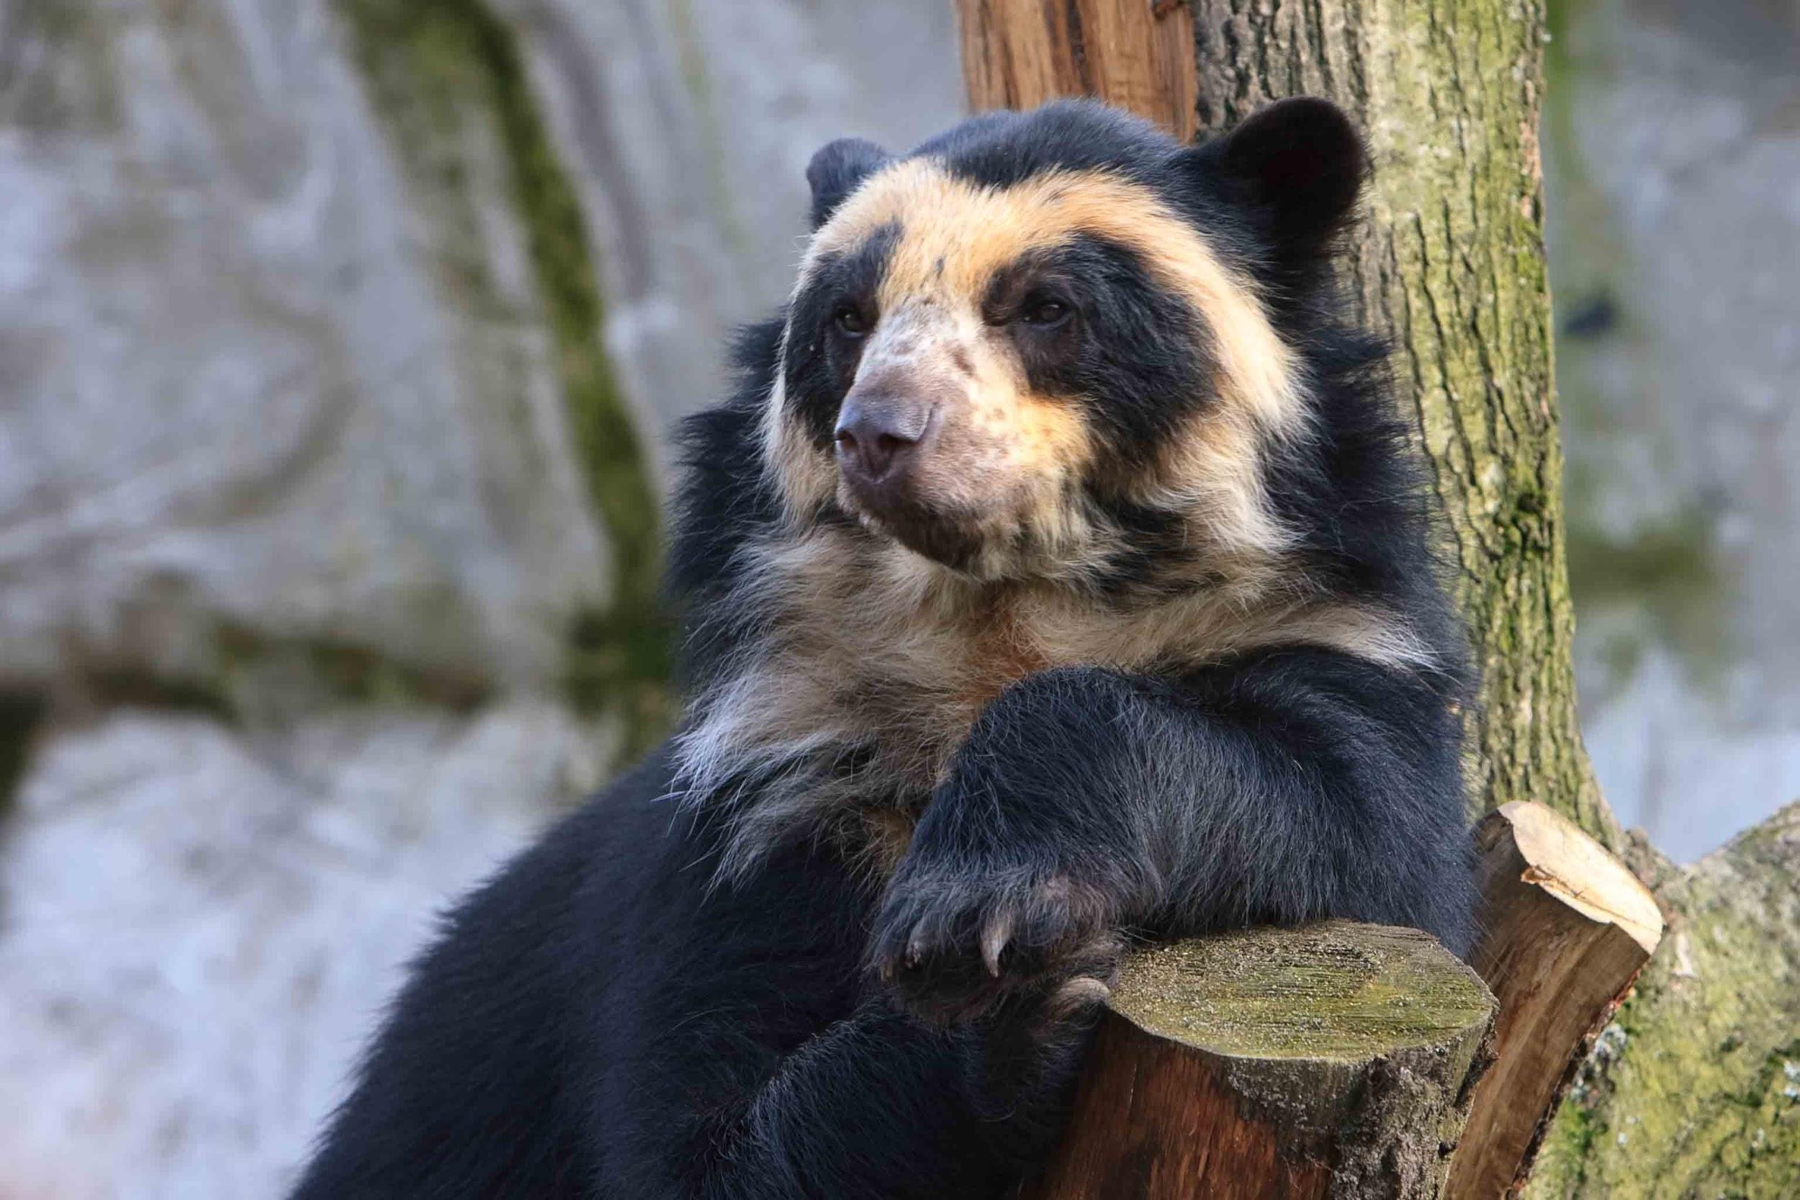
Environmental Concerns
“Colombia's forests are home to many animals—including harpy eagles, tapirs, golden poison frogs, and spectacled bears—that are at risk of extinction”*
Loss of one species can upset the balance of its environment and affect biodiversity.
Angry his people are going extinct.

Slide 6
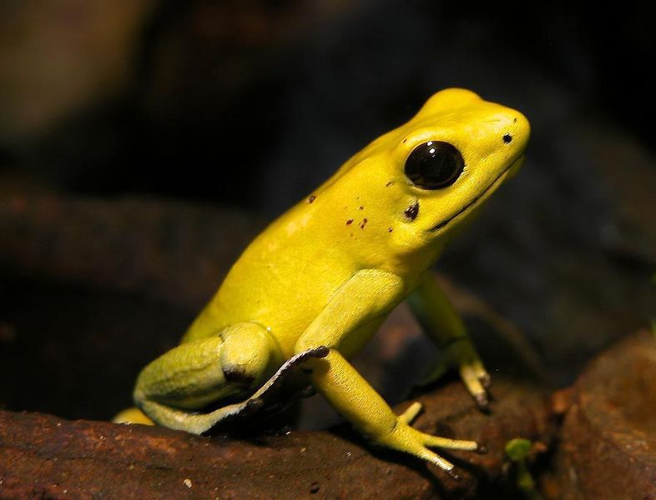
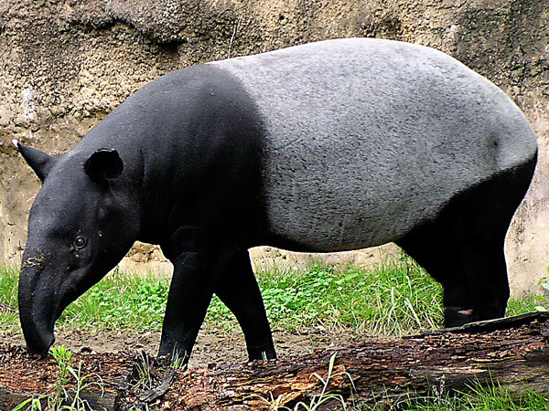
Environmental Concerns
Losing even a small strand in the web of life contributes to the unraveling of our planet's sustainability, and that makes a difference to every single one of us.
Coca growers use plenty of pesticides, many of which are technically banned in Colombia.
~In the words of the World Wildlife Fund:
“When you remove one element from a fragile ecosystem, it has far reaching and long lasting effects on biodiversity”

Slide 7
Social concerns
Long-term effects
Permanent damage to blood vessels of heart and brain
High blood pressure leading to heart attacks, strokes
and death
Liver, kidney and lung damage
Sexual problems, reproductive damage and infertility
Severe depression
Human Health:
Short-term effects
Loss of appetite
Increased heart rate, BP & body temperature
Nausea
Hallucinations
Depression

Slide 8
Social Concerns
Effect on Health pt 2:
An important component of health is a balanced diet. Several hundred species of animals and plants have been used for human food consumption.
Human health, particularly risk of exposure to many infectious diseases, may depend on the maintenance of biodiversity in natural ecosystems. Evidence is accumulating that greater wildlife diversity may decrease the spread of many wildlife pathogens to humans.
Example: The spread of Lyme disease

Slide 9
Social Concern: Quality of Life
Biodiversity offers directly the various goods, often plants, animals, and fungi that individuals need in order to earn an income and secure sustainable livelihoods.
In addition, it also contributes to livelihoods through the support it provides for ecosystem services.
Ecosystem Services: The benefits people obtain from ecosystems.*
(These include food and water & regulating services such as flood and disease control)
*http://www.greenfacts.org/glossary/abc/biodiversity.htm

Slide 10
Social Concern: social structure
Many cultures attach spiritual and religious values to ecosystems
A loss or damage to these components can harm social relations by disrupting religious and social ceremonies that normally connect people.
Damage to ecosystems, highly valued for their aesthetic, recreational, or spiritual values can damage social relations by:
reducing the bonding value of the shared experience
causing resentment toward groups that profit from their damage

Slide 11
Economic Concerns
“...deforestation is driven by clearing land to plant coca bushes, the study found. When remote areas attract growers of illegal coca, they became economic hubs for lots of associated agricultural activities.”
Unfortunately, there are no economic downfalls to the production of cocaine and practice of deforestation
Deforestation + planting= jobs

Slide 12
Economics: GDP and Trade
-drug money accounts for around 1% of GDP
-Colombia is the world's largest cocaine producer and accounted for 43% of global coca cultivation in 2009
-Colombia's drug trade is worth $10 billion ,one quarter as much as the country's legal exports
-Colombian drug cartels made $4.6 billion in profits from exporting to the US

Slide 13
What is being done to help the problem?
Study suggests that boosting the land's protection status is a simple and effective place to start.
Protection slows down deforestation
Other solutions:
Pressuring Corporations and Markets: If corporations have the power to destroy the world’s forests, they also have the power to help save them.
Promoting Sustainable Consumer Options: When consumers speak, corporations listen. (Buying recycled wood products, supporting brands with 0 deforestation policies)

Slide 14
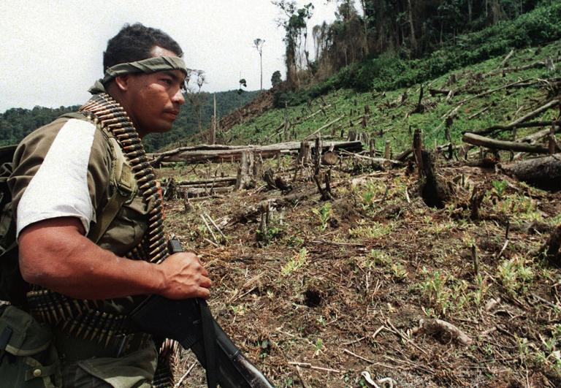
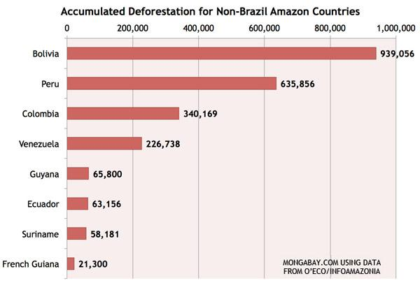
Pictures
“A Colombian soldier in 1992 looks at a deforested land formerly
used for poppy plantations.”

Slide 15
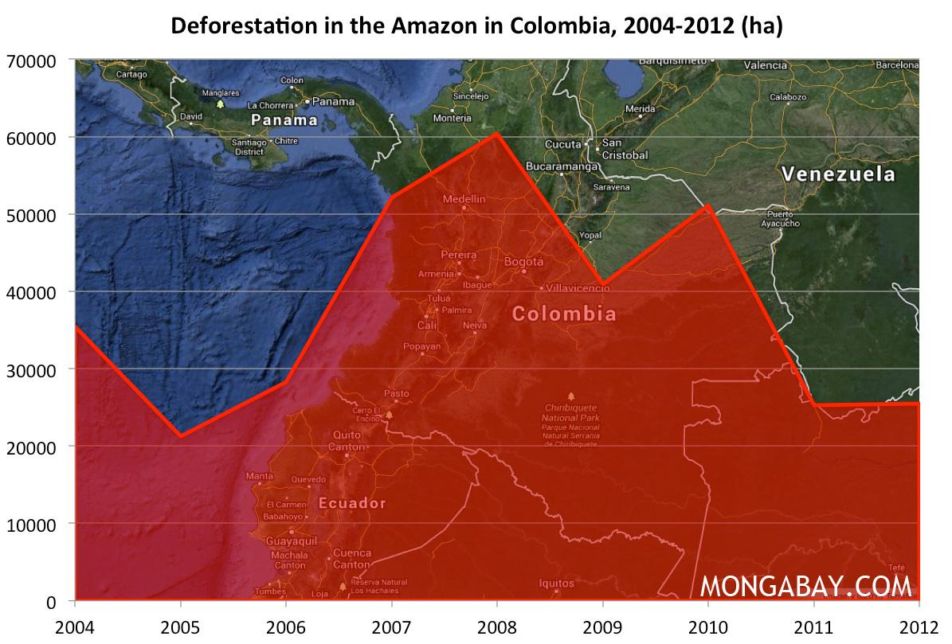

Slide 16
For More Information:
-http://news.nationalgeographic.com/news/2011/02/110218-cocaine-coca-farming-colombia-rainforests-environment-science/
-http://www.greenpeace.org/usa/forests/solutions-to-deforestation/
- http://www.businessinsider.com/colombias-drug-backed-economy-2011-4?op=1
-http://news.mongabay.com/2013/06/deforestation-rates-for-amazon-countries-outside-brazil/
-http://www.drugfreeworld.org/drugfacts/cocaine/effects-of-cocaine.html
-http://www.greenfacts.org/glossary/abc/biodiversity.htm

