Slide 1
Air pollution in China
by Attia Azam

Slide 2
Background Information on China
China population 1,380,268,124
18.72% of the world's population
about 60 % of population is urban
GDP - 10,36 million U.S dollar

Slide 3
What is the issue?
China depends on alot coal
Beijing has issued it second severe warning - which results to closing down schools factories and stop cars from being on the road due to the smog, not being able to see 200ft ahead
China air quality kills 1.4 million each year (4,400 people a day)
Health conditions such as premature mortality like lung cancer, stroke and heart failure

Slide 4
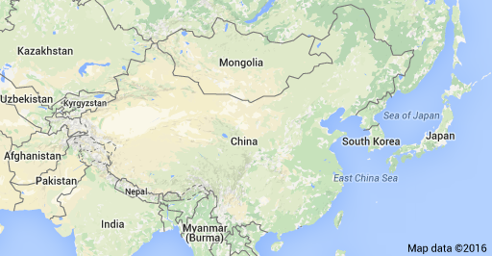
Where in the world?

Slide 5
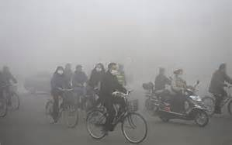
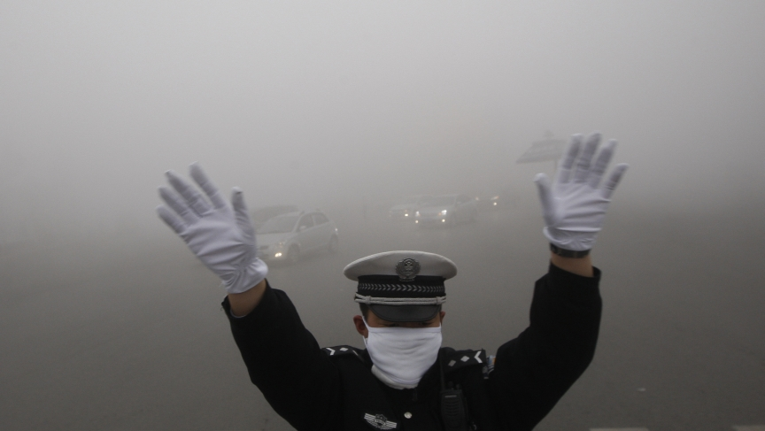
why does it matter?
Pollution in china matters because there are no barriers in the atmosphere where countries cut off.
It overall effect the entire air.

Slide 6
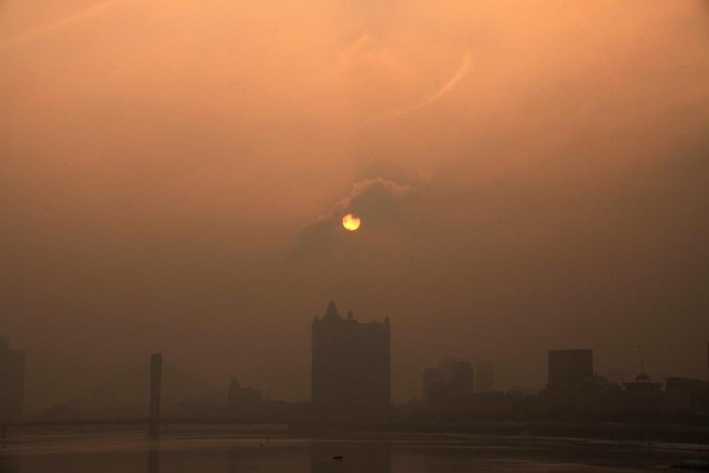

Slide 7
What are the environmental impacts?
Slowing the photosynthesis in plants
Water shortages/contaminated water
Weakened countries food supply

Slide 8
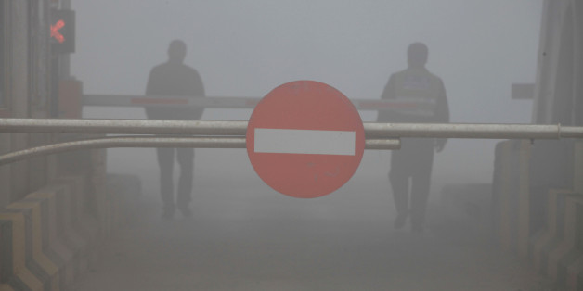

Slide 9
Social concerns
Cancer is now the number 1 factor of death in China
Due to the smog a lot of health conditions such as lung cancer heart failure, stroke
China’s economic development has come from the dependence of cheap energy, coal.
Always must carry a mask.

Slide 10
Economic concerns
Since China was in a rush to industrialize at a quick rate - 70% of their companies are making a negative profit.
Household consumption is low
Economic suicide-where workers threaten their lives for wages
A decrease of wages due to really bad day where smog is too much and schools and factories have to be closed

Slide 11
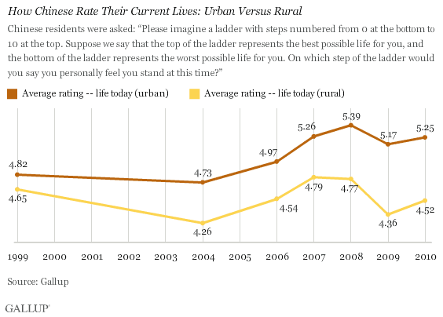

Slide 12
What is china doing to improve air quality?
China has to reduce coal amounts to improve health conditions and quality of life.
Reduce steel capacity by 150 million tons
500 million tons of coal
With a decrease of production leads to cutting 1.8 million state owned jobs

Slide 13
Sources
http://www.greenpeace.org/eastasia/campaigns/air-pollution/problems/
http://www.worldometers.info/world-population/china-population/
http://time.com/4155365/china-red-alert-smog/
http://time.com/4035670/air-pollution-death/
http://www.nbr.org/research/activity.aspx?id=397
http://www.theguardian.com/world/2014/feb/25/china-toxic-air-pollution-nuclear-winter-scientists

Slide 14
sources
http://www.ibtimes.com/china-air-pollution-smog-blankets-beijing-shanghai-day-after-christmas-2240081
http://bsccomment.com/2016/03/03/protests-rise-as-china-lays-off-millions-of-coal-workers.html

